Slide 1
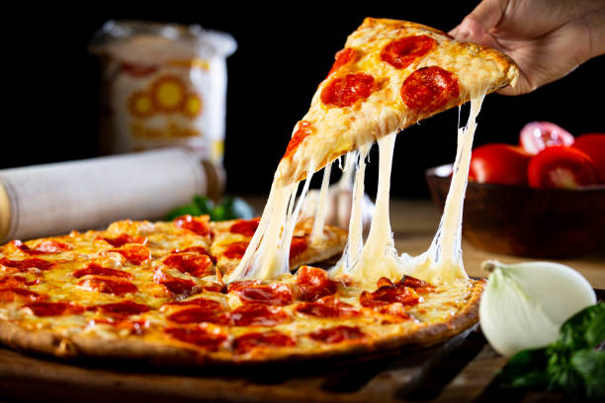
PIZZA SALES REPORT
2015

Slide 2
Content
Objective
Data Overview
Methodology
Analysis and Findings
Conclusion
Appendices

Slide 3
Objective
Aim to analyse and review pizza sales performance over specific period. By examining key metrics and insights, optimize SQL queries for better performace.

Slide 4
Data Overview
Import csv file to SQL workbench

Slide 5
Methodology
Outline the SQL techniques and methods used for analysis
Joines- Inner Join
Aggregations- SUM(), AVG(), COUNT()
Filtering- Where Clause
Windows Function- RANK()

Slide 6
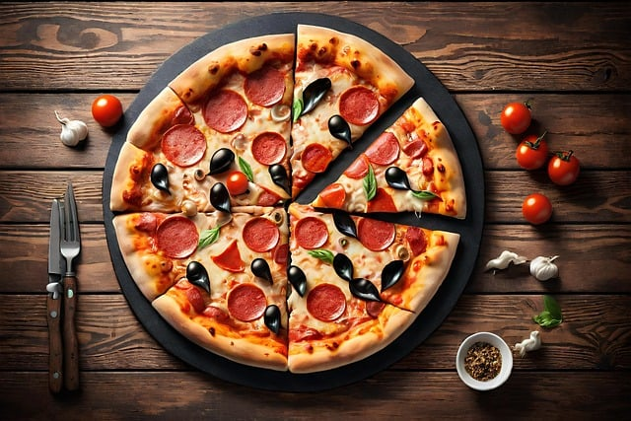
Analysis And Findings

Slide 7
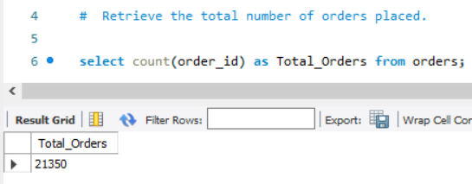
Total number of Order placed
21350 total orders we get in 2015.

Slide 8
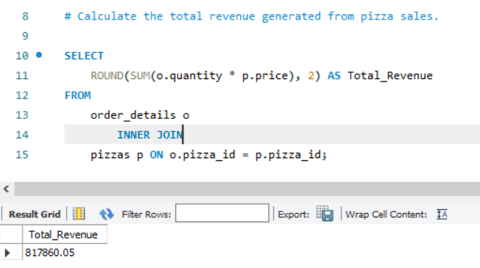
Total revenue generated from pizza sales.
817860.05 is a total revenue

Slide 9
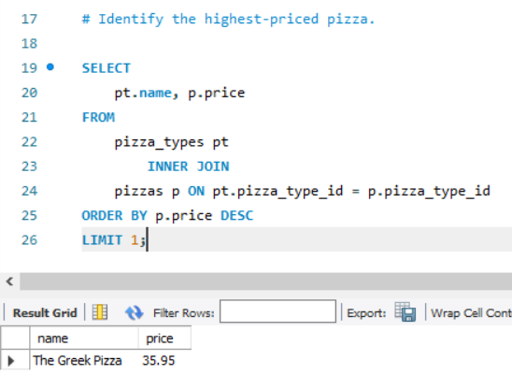
Highest Priced Pizza
The Greek Pizza

Slide 10
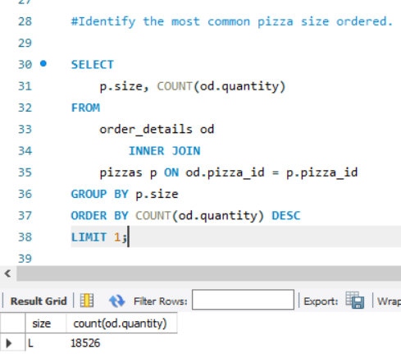
Most common pizza size ordered
Most of the time customers buy L size of Pizza compare to others.

Slide 11
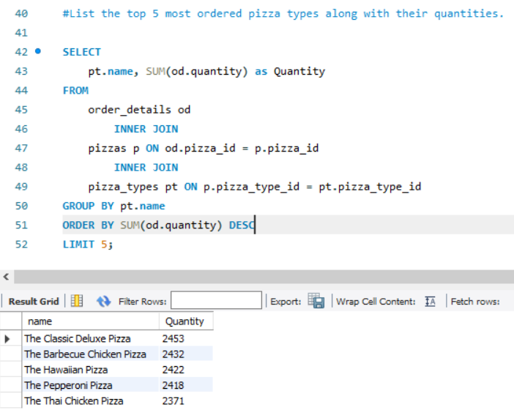
Top 5 most of ordered pizza types
The Classic delux pizza
The Barbrcue Chiken Pizza
The Hawailan Pizza
The Pepperoni Pizza
The Thai Chiken Pizza

Slide 12
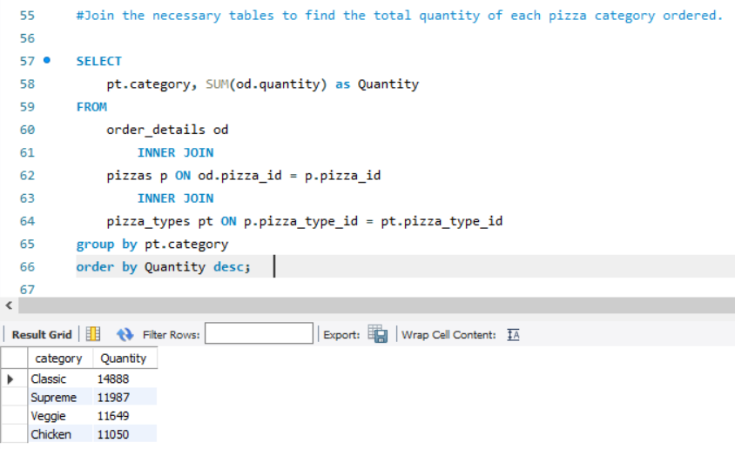
Quantity of each pizza category ordered
Classic Pizza ordered most of the time

Slide 13
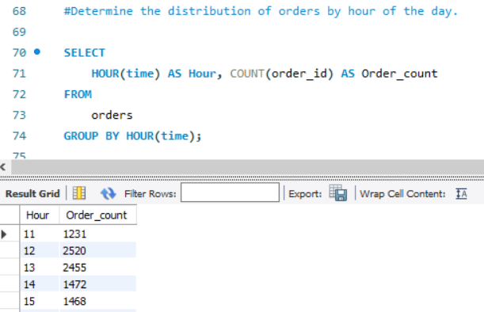
Distribution of orderd hour of the day

Slide 14
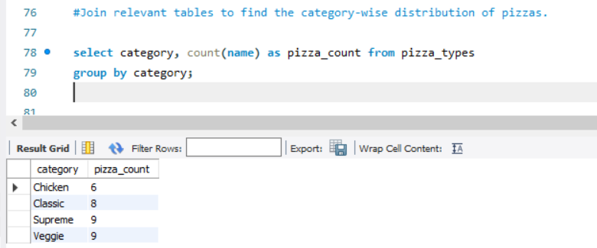
Category wise distribution of pizzas
Chicken have 6 types of pizza
Classic have 8 types of pizza
Supreme have 9 types of pizza
Veggie have 9 types of pizza

Slide 15
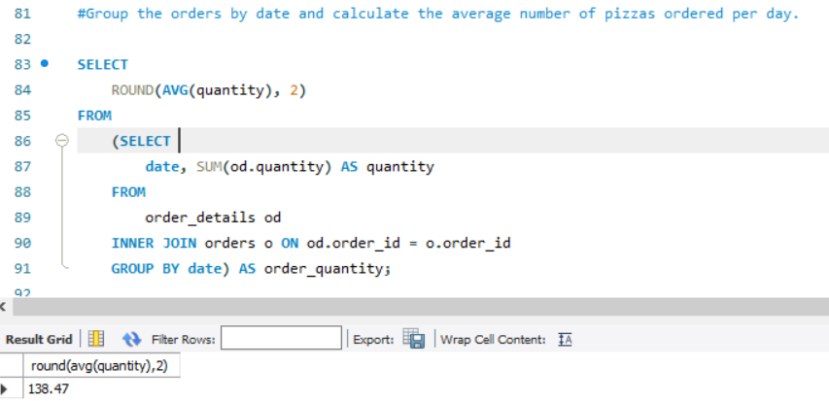
Average number of places ordered by per day
138.47

Slide 16
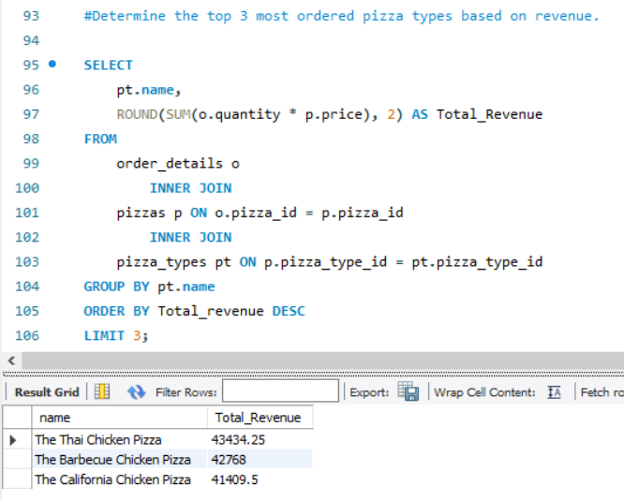
Top 3 most ordered pizza by Revenue
The Thai Chicken Pizza
The Barbecue Chicken Pizza
The California Chicken Pizza

Slide 17
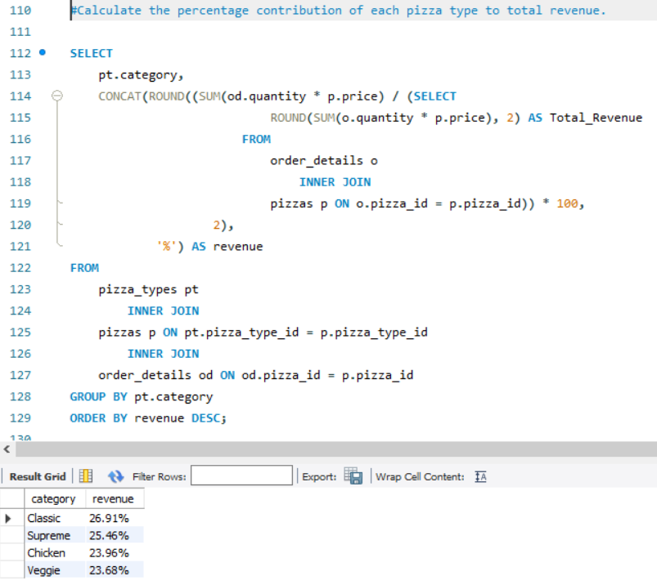
Revenue in % for each Category
Classic have highest contribution i.e. 26.91% .

Slide 18
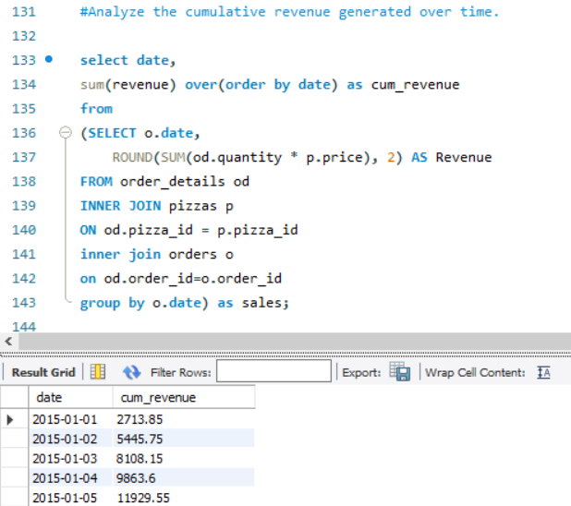
Cumulative Revenue over Time
2015-12-31 - 817860.05

Slide 19
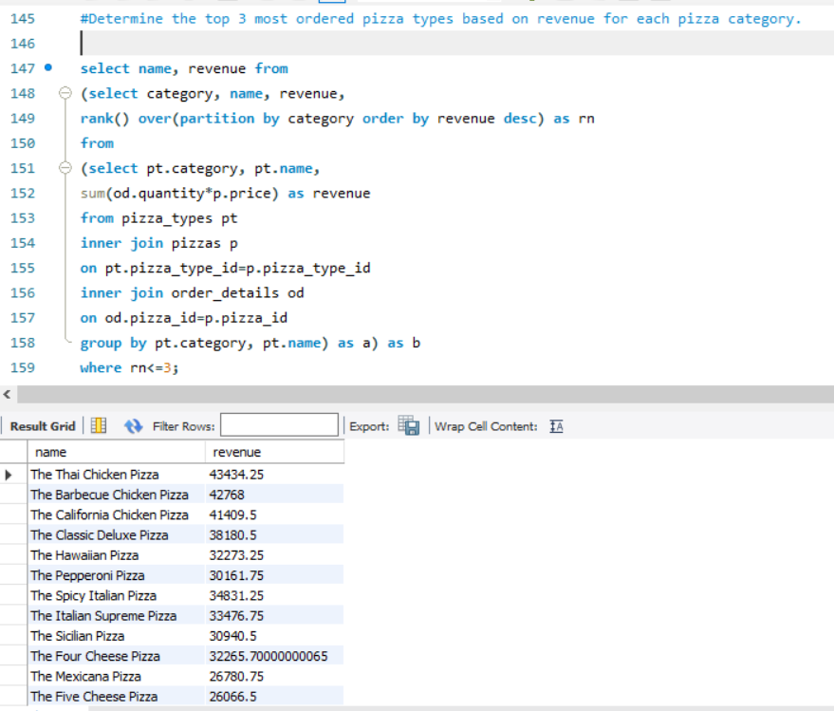
3 most Ordered pizza for each category

Slide 20
Conclusion
Total revenue generated is 817860.05.
Customer buying L size of Pizza mostly
Most of the pizza ordered by Classic and Supreme Category, 26.91%and 25.26% contribution respectively.

Slide 21
Thank YOU

